Slide 1
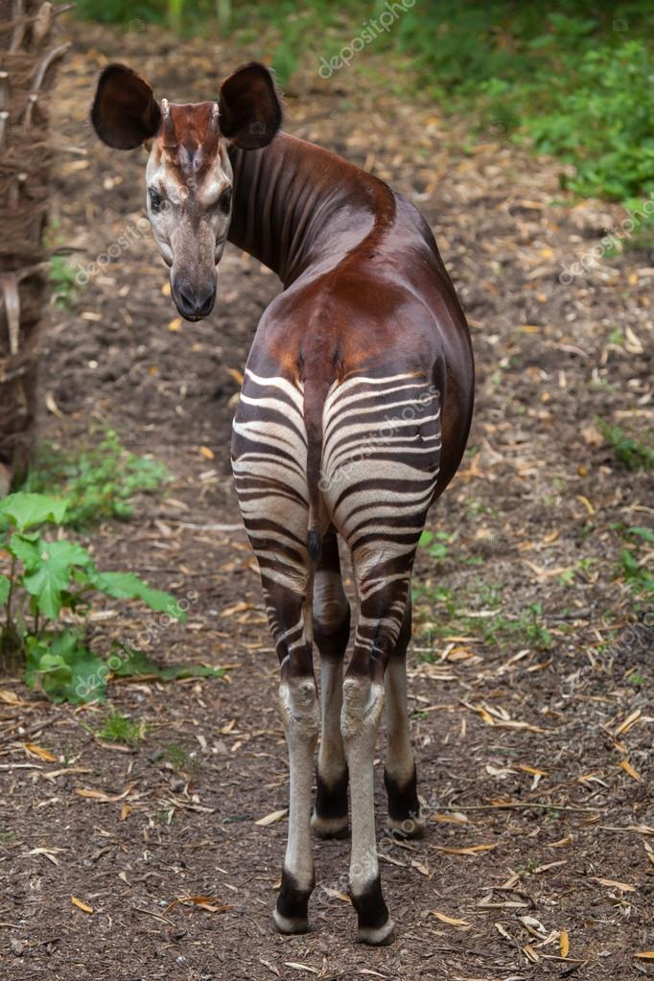
Dynamics of Motor Cortex: Intrinsic or Extrinsic?
Okapia Johnstoni
Jennifer Jensen, Shruti Marathe, Jiaxin Cindy Tu, Chris Versteeg

Slide 2
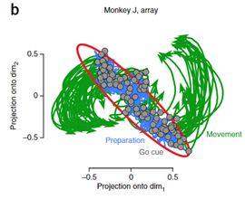
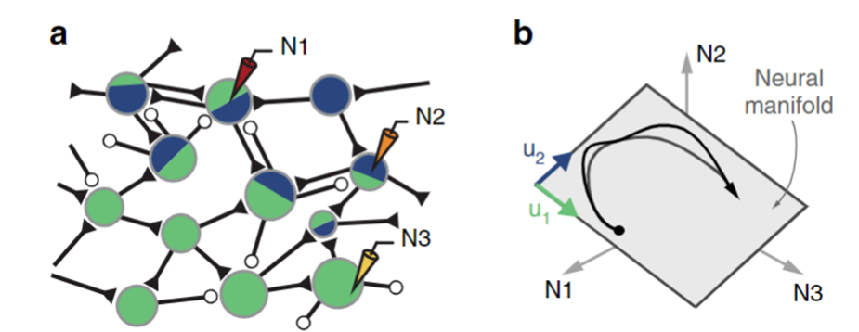
What are “Neural Dynamics”

Slide 3
Questions
To what extent are dynamics recorded in motor cortex shared dynamics across the brain?

Slide 4
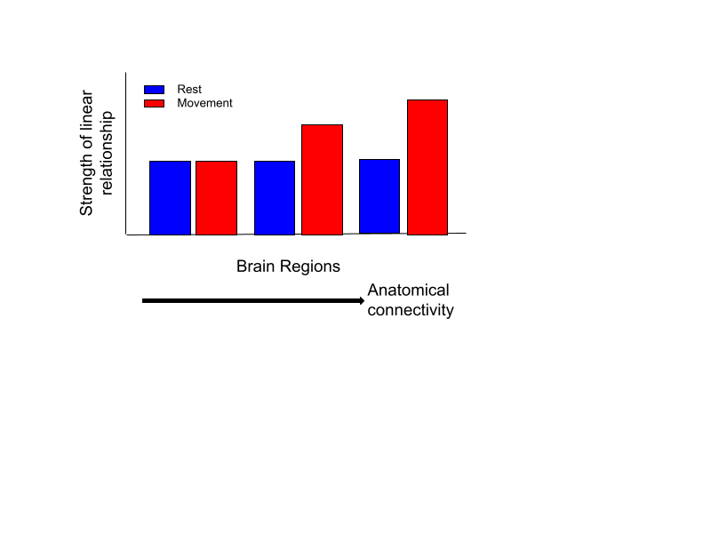
Hypothesis
At rest, neural activity of all brain regions will share few features. During movement, regions anatomically connected to motor cortex will interact more.
Notes:
At rest, neural activity of all brain regions will share few features. During movement, regions anatomically connected to motor cortex will interact more.

Slide 5
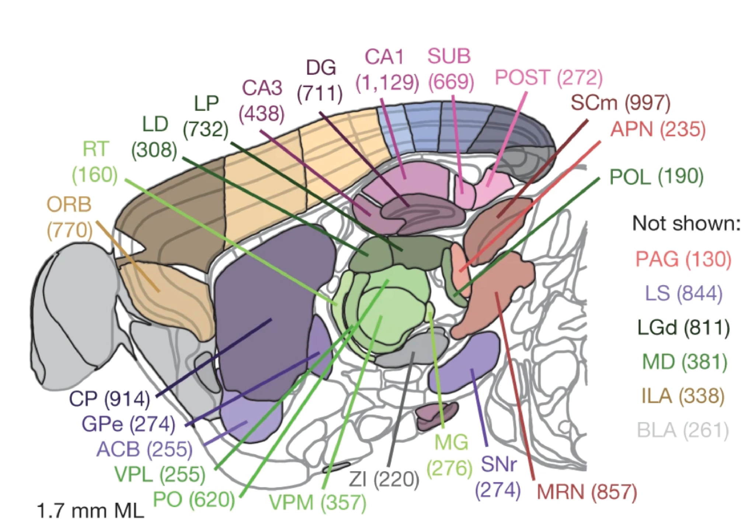

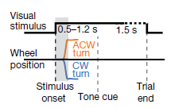
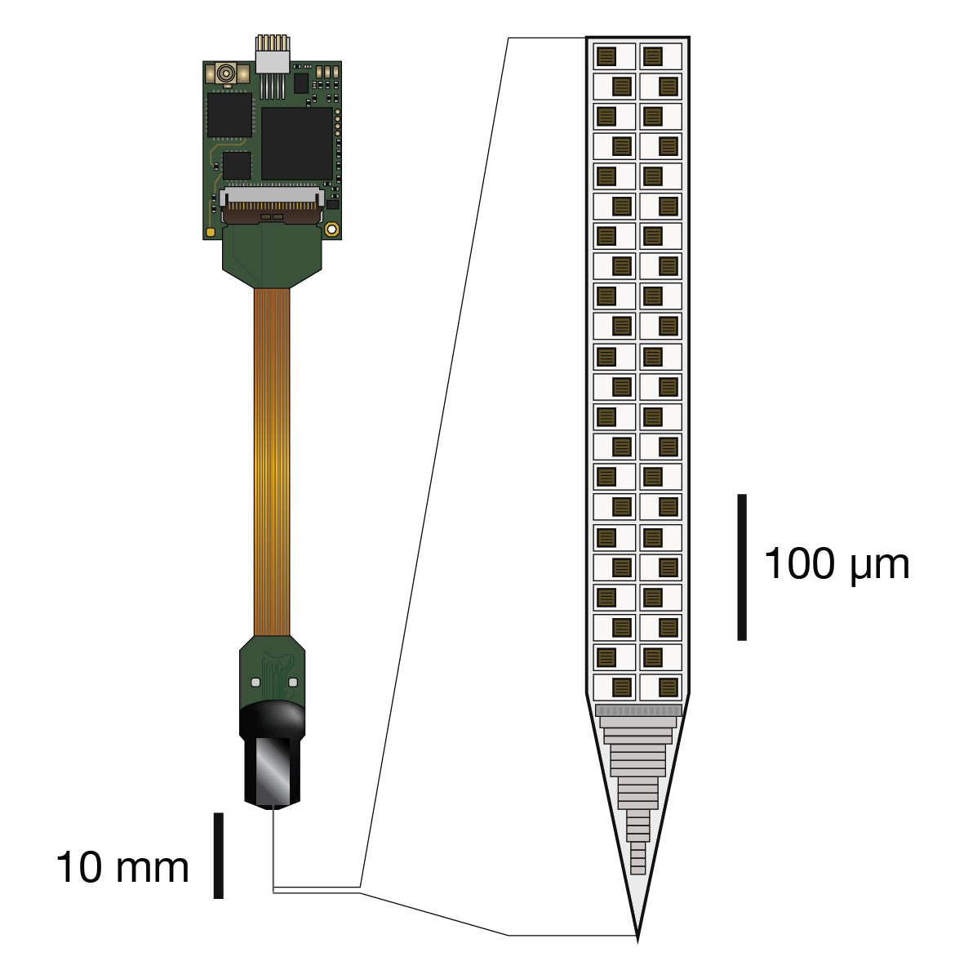
Steinmetz Dataset
Session 31
Brain Region
Secondary Motor Cortex | Thalamus | Orbital Frontal Cortex | Olfactory Bulb | Hippocampus: CA3 | Postsubiculum | Superior Colliculus | Substantia Nigra
281 | 78 | 291 | 109 | 43 | 17 | 41 | 117
# of neurons

Slide 6
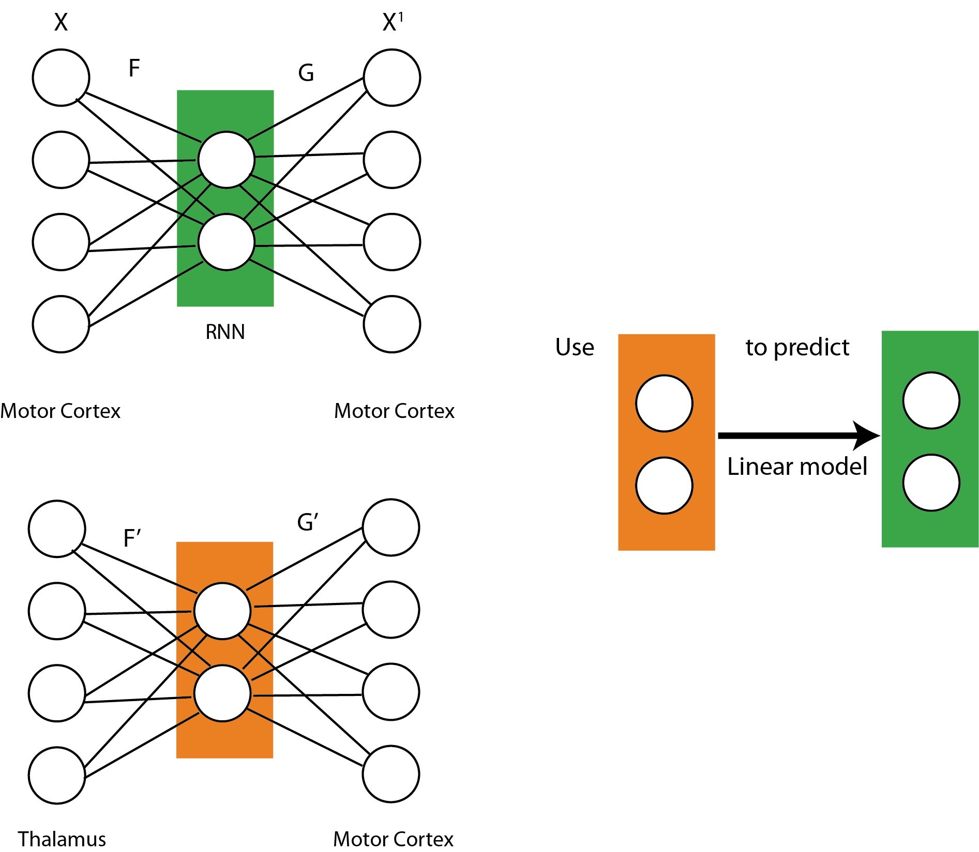
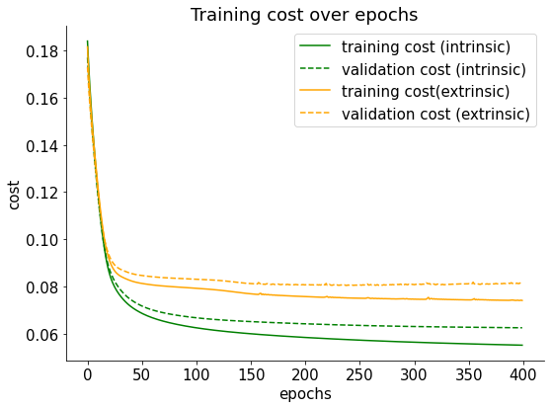
Modeling shared latent dynamics between Motor Cortex and other brain regions
Intrinsic
Extrinsic
Notes:
The level of interaction can be measured by the strength of the linear relationship between latent spaces, indicating shared neural activity dynamics.

Slide 7
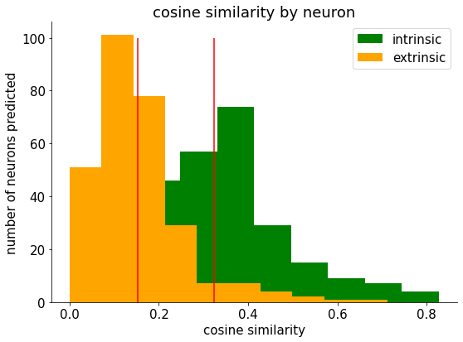
Our model were able to reconstruct the spikes with a reasonable degree of accuracy

Slide 8
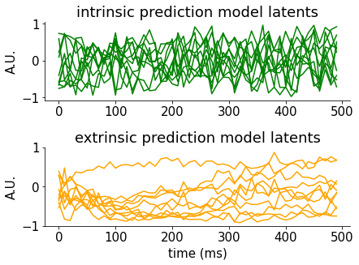
Modeling shared latent dynamics between Motor Cortex and other brain regions
Intrinsic
Extrinsic
Notes:
The level of interaction can be measured by the strength of the linear relationship between latent spaces, indicating shared neural activity dynamics.

Slide 9
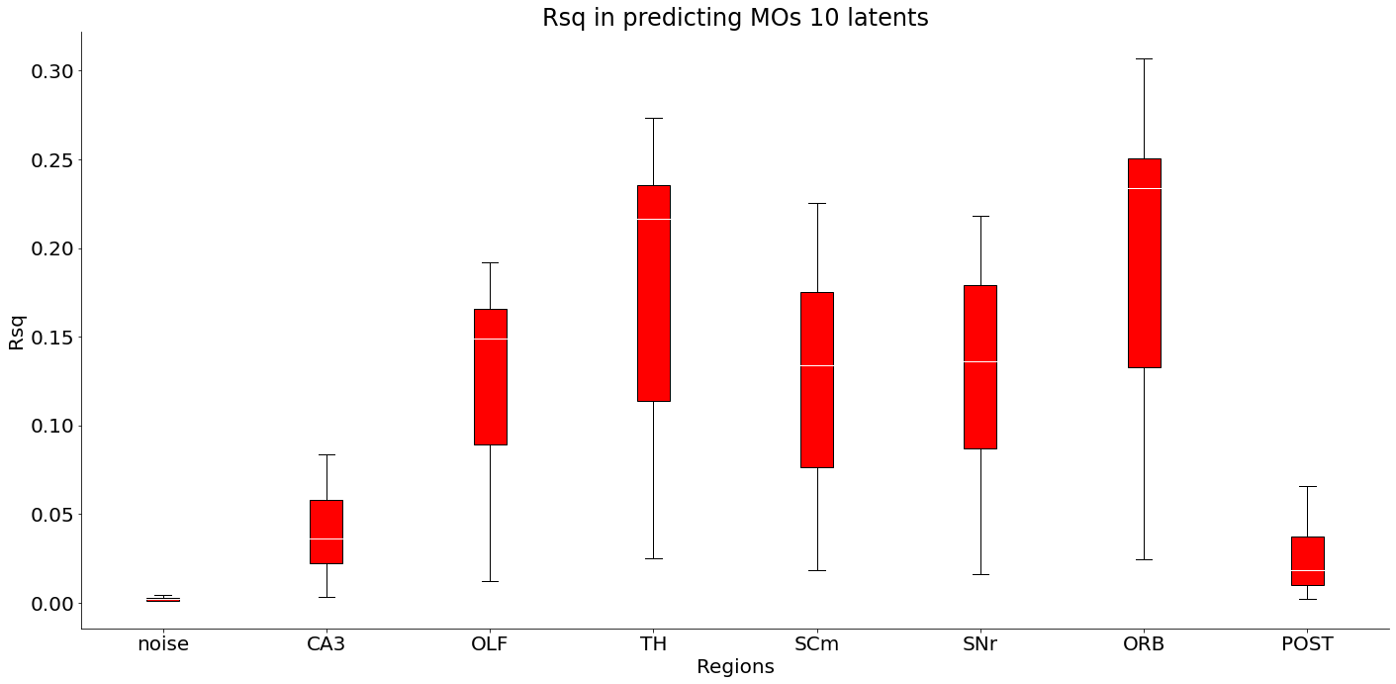
Alignment of latent spaces during movement is stronger than the noise control and varies across regions
Notes:
So here are our results. We found that during movement, there’s more alignment between the latent spaces, suggesting of some extrinsic contributions of dynamics during movement.

Slide 10
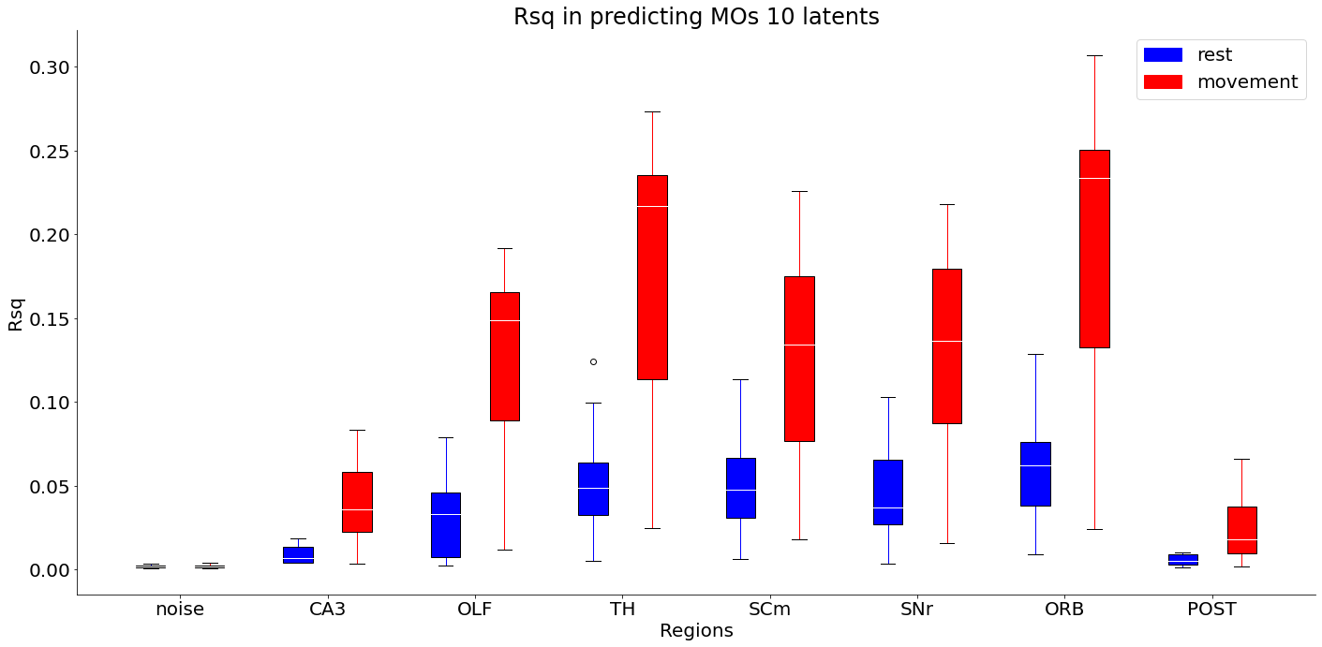
Alignment of latent spaces is stronger during movement compared to at rest
Notes:
Also, comparing to rest, there is in general an increase in the alignment of latent spaces during movement.

Slide 11
Limitations and future directions
The number of neurons in each region is not the same -> varies by a lot
Can systematically explore the effect of number of neurons in the “shared latents”
Only one session from one mice
Extend to other sessions/more mice
Examine different tasks/behavior states of the animal

Slide 12
Conclusion
We used dynamic systems to estimate the correlations between brain regions across behavioral states.
We found that during movement, motor cortex shares more common dynamics with other brain regions.

Slide 13
Thanks!
TA:
Naga Karthik
Advisor:
Aakash Agrawal
Data Source
Nicolas Steinmetz
Neuromatch Community!

Slide 14
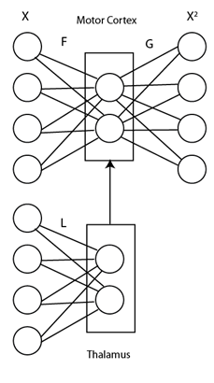
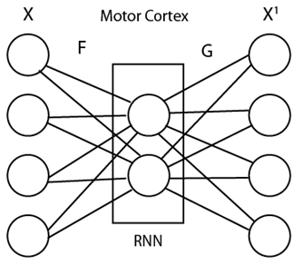
How much are dynamics recorded in motor cortex shared with dynamics of external inputs?
Case 1: Motor cortex has strong intrinsic dynamics:
Case 2: Motor cortex dynamics are input driven

Slide 15
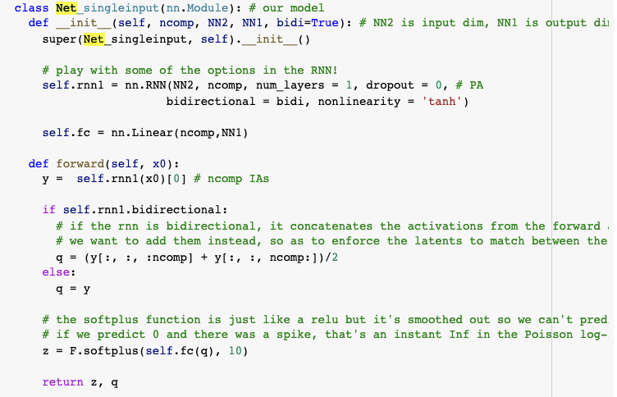
Model

Slide 16
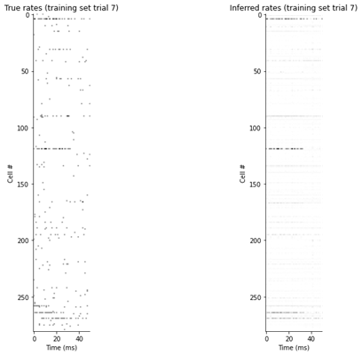
RNN Autoencoders were able to broadly capture firing rates of neurons in cortex
Average correlation between actual and predicted firing rates of ~ 0.45

